Slide 1
Scaffold-Based Analytics: Enabling Hit-to-Lead Decisions by Visualizing Chemical Series Linked Across Large Datasets
Deepak Bandyopadhyay,
Constantine Kreatsoulas,
Pat G. Brady, Genaro Scavello, Dac-Trung Nguyen, Tyler Peryea, Ajit Jadhav
Thanks to:
Lena Dang and Josh Swamidass (WUSTL),
Stephen Pickett, Martin Saunders, Nicola Richmond, Darren Green, Eric Manas, Todd Graybill, Rob Young, Mike Ouellette, Stan Martens, Javier Gamo, Lourdes Rueda
GSK
NCATS

Slide 2
Outline
Introduction:
Merging disparate screening output
Methods – Scaffold Analytics
Limitations of Clustering
Walking between Scaffolds
Scaffold Generation Methods
Results – Linking series across datasets
Hit prioritization & Scaffold Hopping (TCAMS)
Dataset Integration & Scaffold Progression (Kinase X)
Conclusion

Slide 3
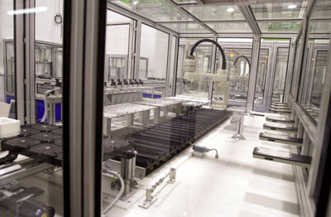
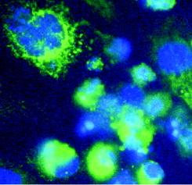
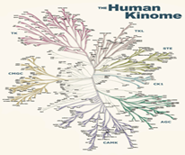
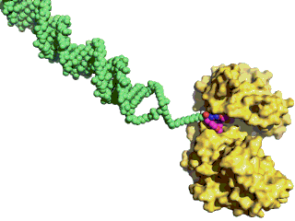
Small Molecule Lead Discovery at GSK
High Throughput Screening
Maximize chemical diversity
Miniaturized assays, automated QC
Intelligent hit selection
Fragment Hit ID
Low Mol Wt starting points
High ligand efficiency
Biophysical techniques
High-Content / Phenotypic Screen
Human Disease-Relevant Assays, often image-based
Target agnostic/ID later
GSK,
Tres Cantos,
Spain
Encoded Library Technology
Unique GSK asset
Rapidly-improving collection
Small scale process
Focused Screening
Exploit connectivity of targets
Biased to certain target types
Small scale process
Screening output: large, diverse, and difficult to navigate

Slide 4
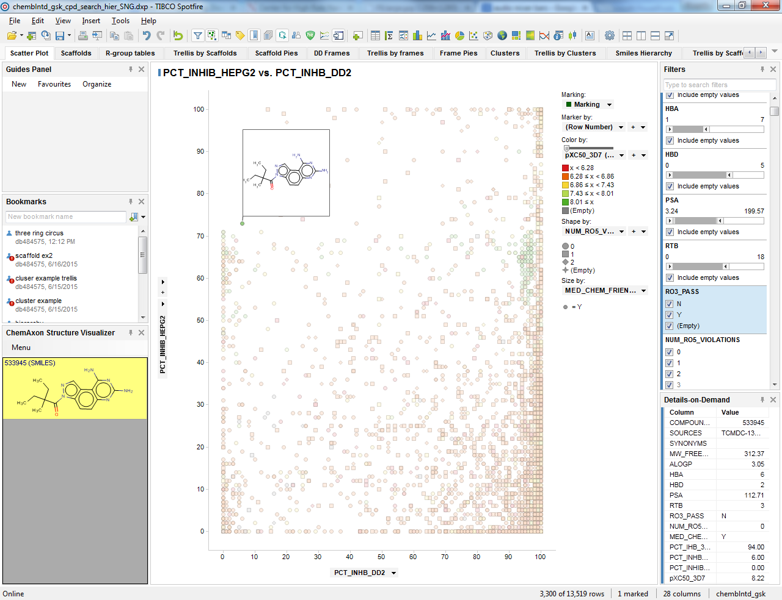
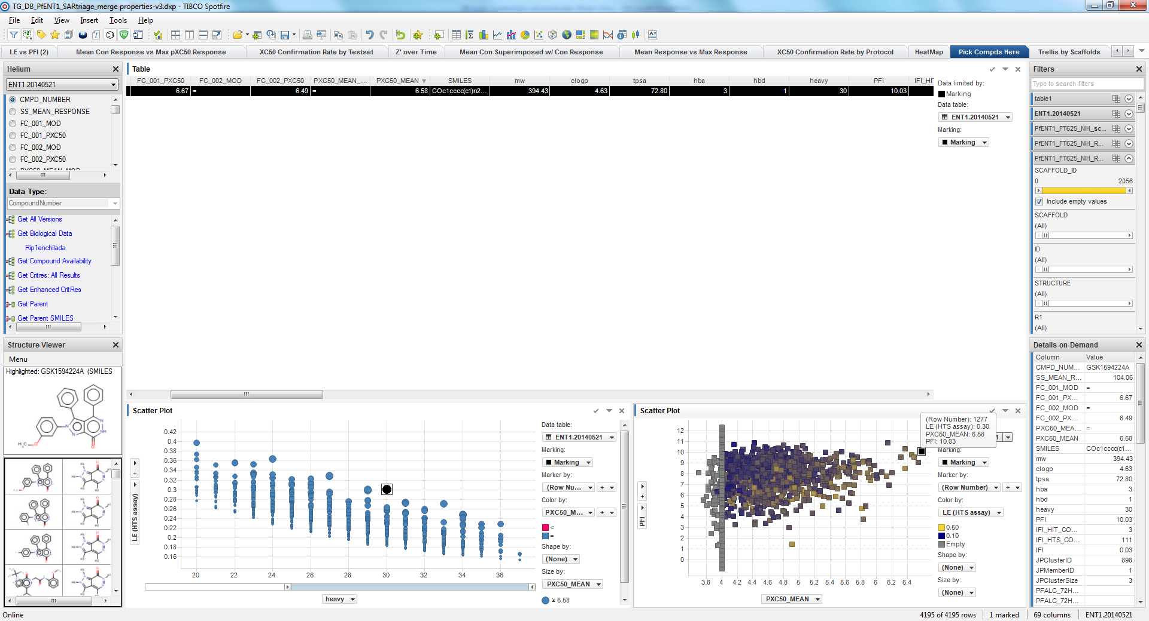
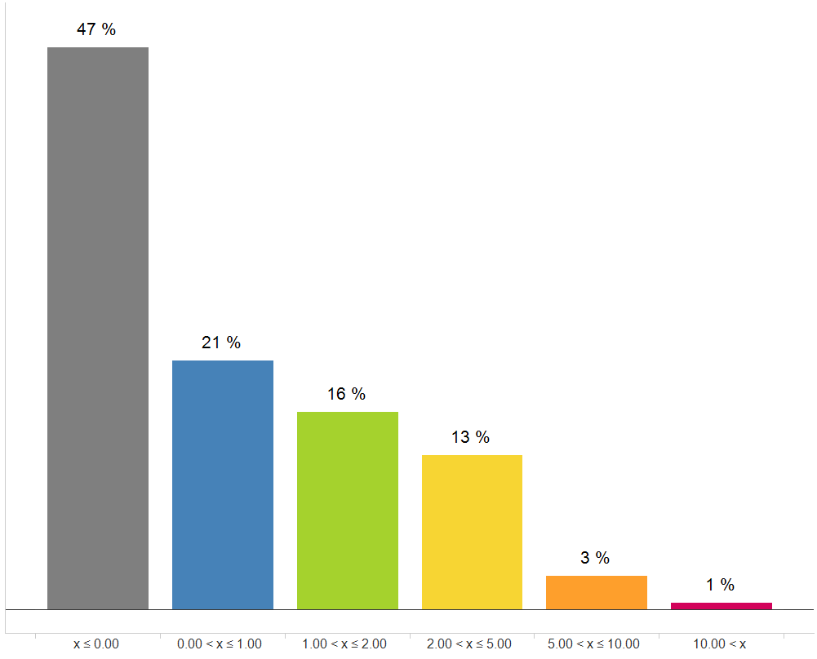
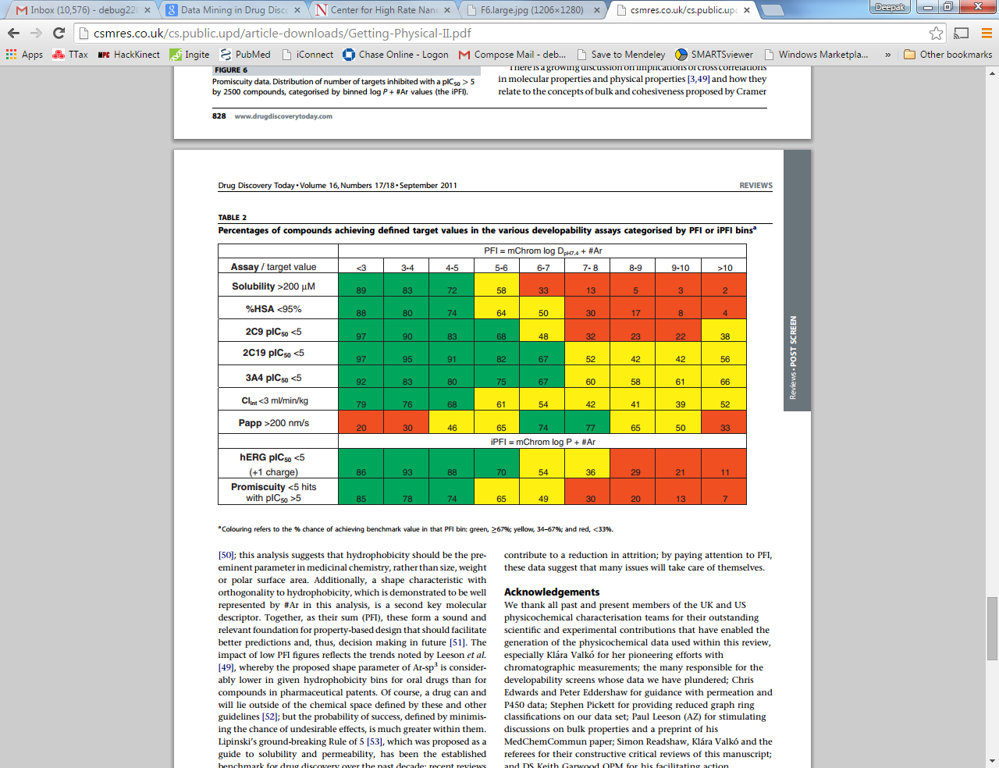
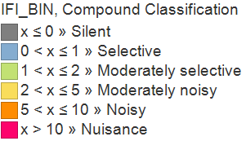
Hit Triage on Individual Compounds
Use case: isolate good chemical starting points and weed out bad ones
Criteria
Potency in a suite of assays
Selectivity against off-targets
Physical/Chemical Properties
MW, solubility, permeability,…
Property Forecast Index (PFI)
Inhibition Frequency Index (IFI)
Filters
Orthogonal assay (pIC50)
a.k.a. Manual Data Surfing
Primary bioassay (pIC50)
% chance
of good
outcome
>67%
33-67%
<33%
PFI = Chromatophic LogD + # of aromatic rings
R. Young, D.V.S. Green, C. Luscombe, A. Hill. Drug Discovery Today Volume 16, Numbers 17/18 September 2011 R
IFI = # HTS assays Hit *100
# HTS assays Tested
S. Chakravorty, ACS 2013

Slide 5


Datasets Used in this Presentation
Tres Cantos Anti-Malarial Set (TCAMS)
13.5k public compounds from GSK HTS
XC50 against Plasmodium falciparum (PF) “susceptible” 3D7 strain
Percent inhibition against “resistant” DD2 strain
Other properties including IFI
In-house data on Kinase X
HTS, FBDD, ELT, Chiromics data
Hit
Prioritization
Scaffold
Hopping
?
Dataset
Integration

Slide 6
Outline
Introduction:
Merging disparate screening output
Methods – Scaffold Analytics
Limitations of Clustering
Walking between Scaffolds
Scaffold Generation Methods
Results – Linking series across datasets
Hit prioritization & Scaffold Hopping (TCAMS)
Dataset Integration & Scaffold Progression (Kinase X)
Conclusion

Slide 7
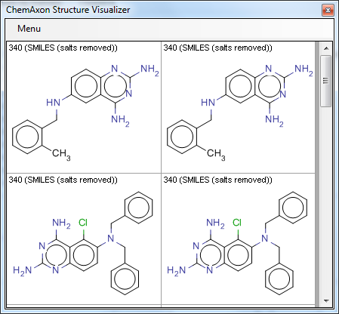
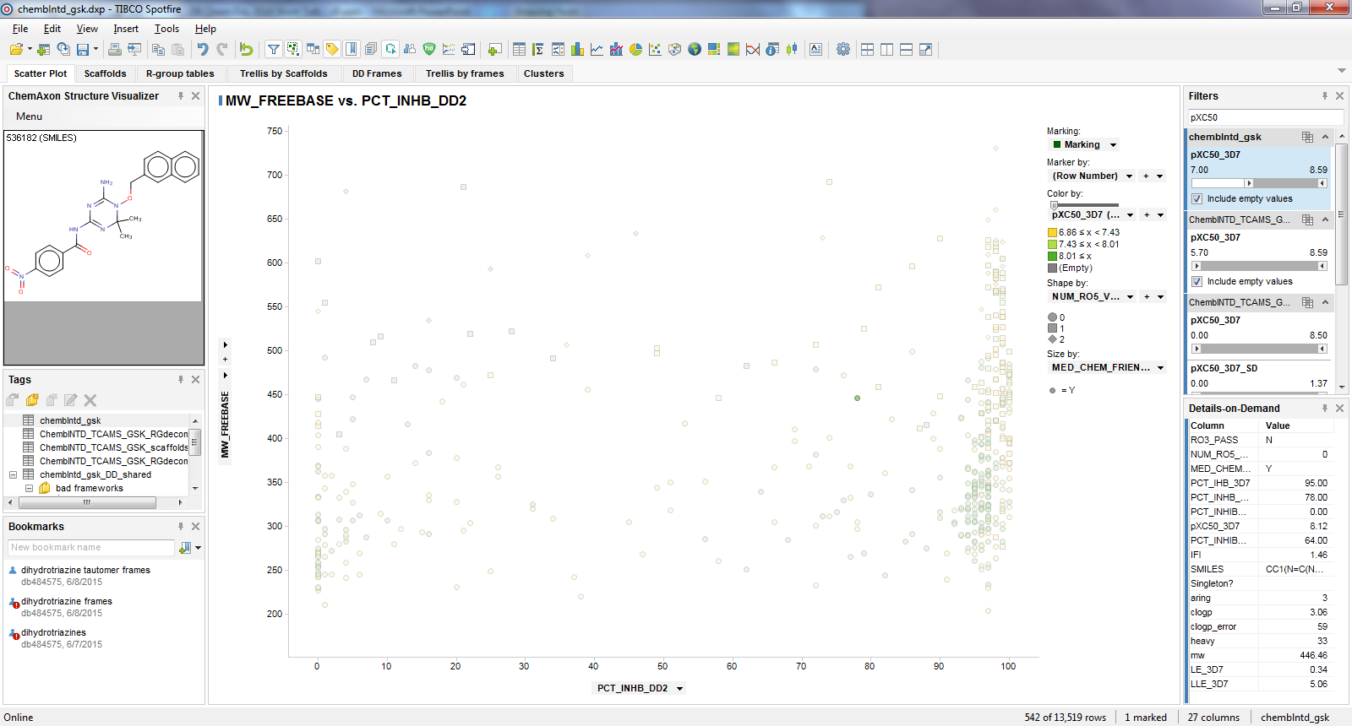
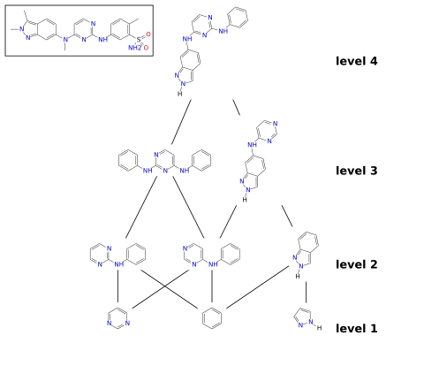
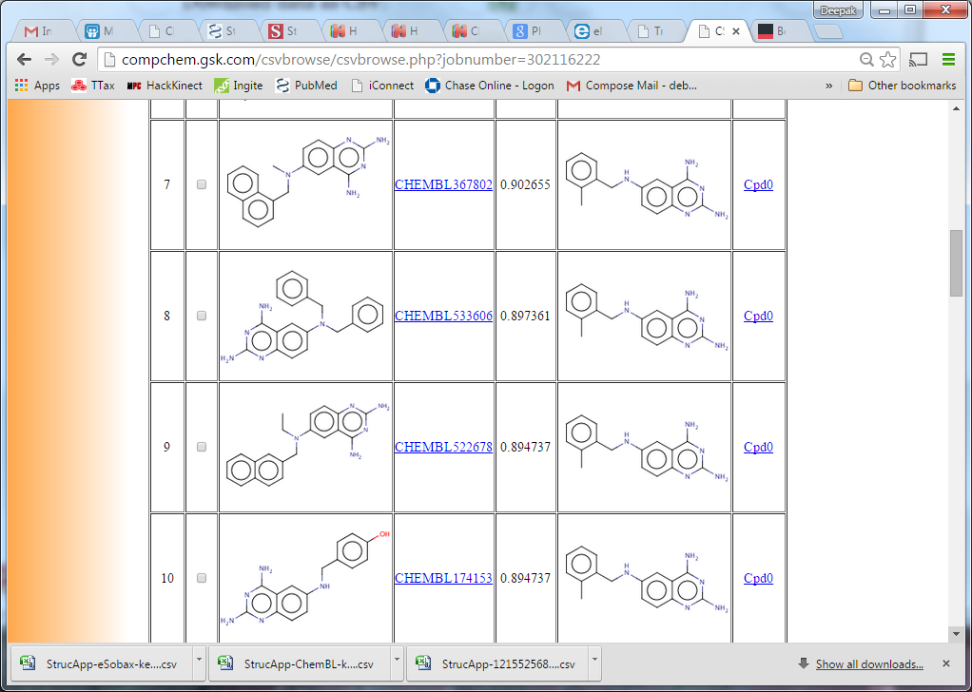
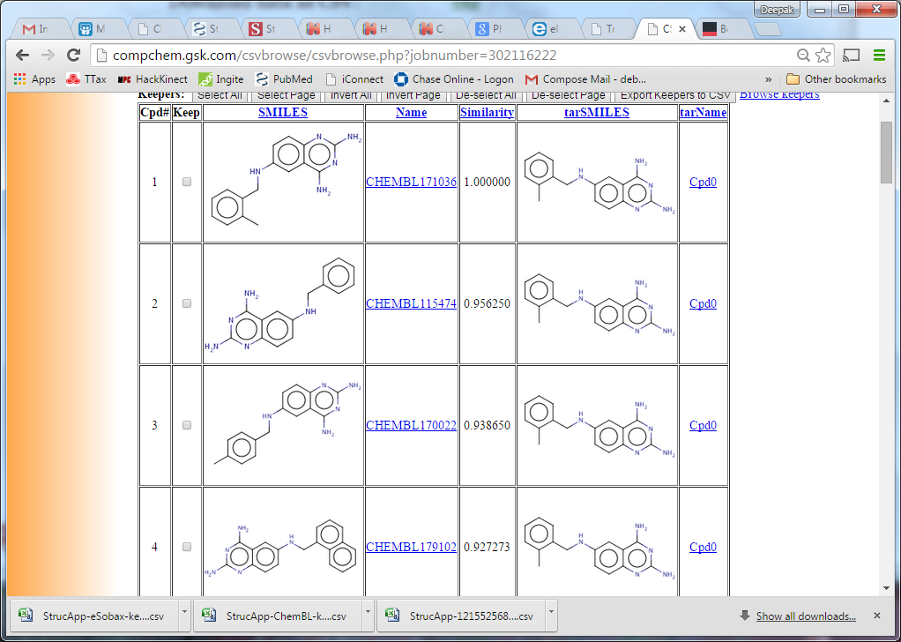
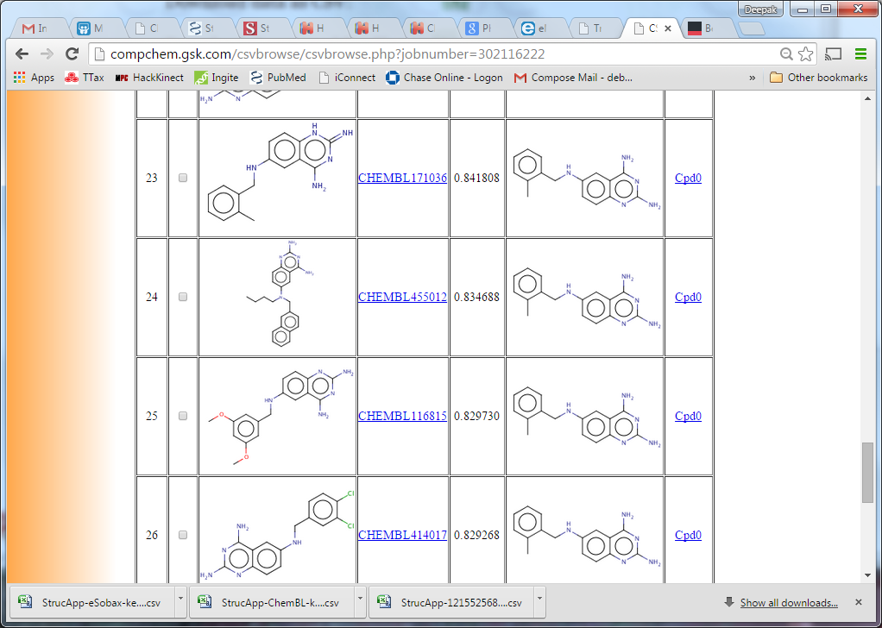
Partially Automated “Data Mining” of Hits
Screening output is heterogenous – manual scaffold-based SAR is ineffective
Hit ID datasets of 5-50k compounds can easily have thousands of cores/chemotypes
Need to explore and elucidate SAR from the data
…and to combine and find synergies across multiple datasets
Traditional solutions: clustering, substructure/similarity searches, …
Hierarchical Clustering
Multiple Substructure Searches
Agglomerative Clustering
Scaffold
Network
(adapted
from J.
Swamidass,
swami.wustl.edu)
Similarity Search
SSS1
SSS2
SSS3
0.9
Manually Merge Results
0.84

Slide 8

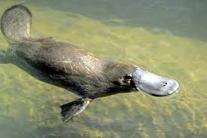



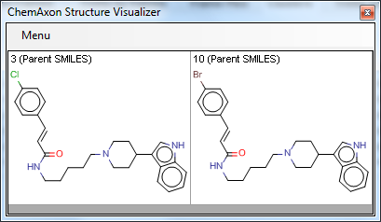
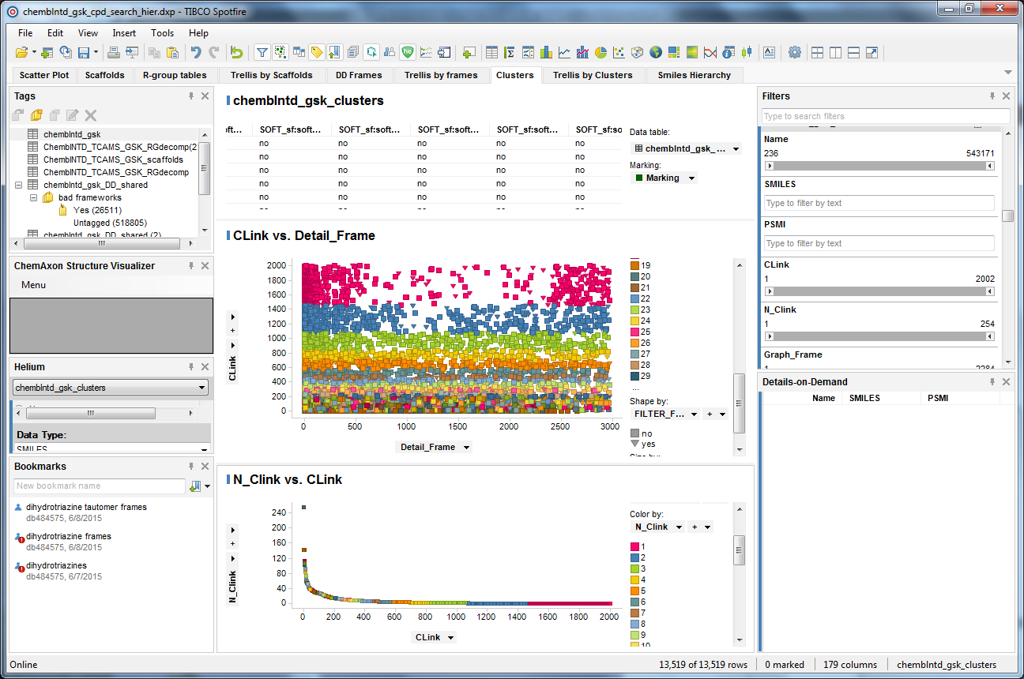
Clustering Is Not Enough for SAR Navigation
Molecule → single cluster, can be limiting
seals (fur)
Agglomerative Clustering:
Hierarchical Clustering:
Level of hierarchy adds extra detail (e.g. # rings in a Scaffold Tree / Network)
ducks
(bill)
?
?
?
?
penguins (flipper)
singleton
similar molecules ≠ same cluster
Many singletons
Cluster 3
Cluster 10
Cluster Size
Complete Link Cluster ID

Slide 9
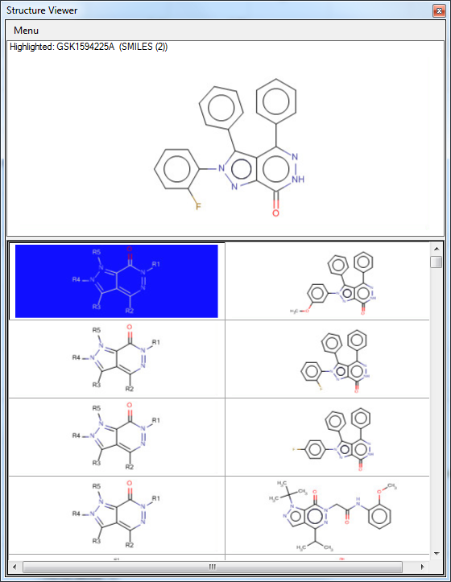
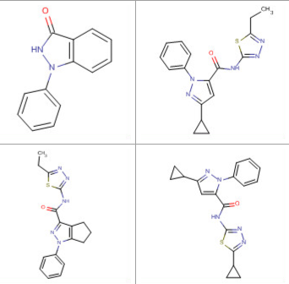
Proposed Improvement: Automatic Decomposition into All (Overlapping) Scaffolds
pIC₅₀
6.6
LE 0.3
Molecule
Scaffold(s)
PFI_{pred}
10
Related Molecules
Notes:
What I will be describing is a method that exhaustively finds all possible shared (or common or frequent) substructures – which we call scaffolds within your data set using a tool from the NIH.
Here is a screening hit that I will use to demonstrate this.
… (don’t need to go into gory details)
Biaryl substructure is contained in these molecules that have low similarity to the original hit molecule.

Slide 10
Next Step: Combine with Activities and Properties
Avg
pIC₅₀
6.4
Avg
LE 0.3
Avg
pIC₅₀
5.8
Avg
LE 0.3
Avg
pIC₅₀
4.3
Avg
LE 0.3
Avg
PFI_{pred}
10
Avg
PFI_{pred}
9.8
Avg
PFI_{pred}
7.7
6.4
0.3
6.4
0.3
5.0
0.43
5.4
0.31
10.3
10.3
6.3
0.3
6.3
0.3
6.1
8.2
5.0
0.23
5.3
0.29
9.5
9.5
<4
N.A.
9.3
9.8
8.2
Notes:
We can aggregate activities & properties at the scaffold-level and then drill-down to the underlying data for individual compounds to progress scaffolds of interest.

Slide 11
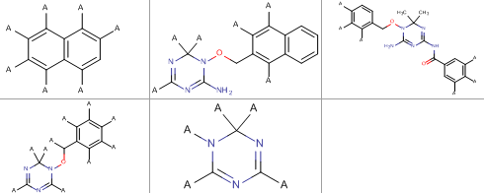
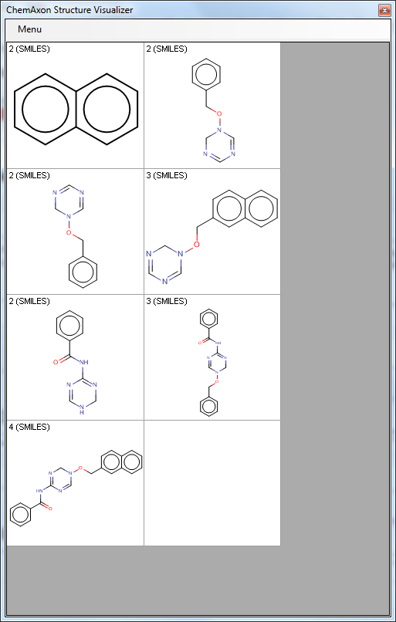
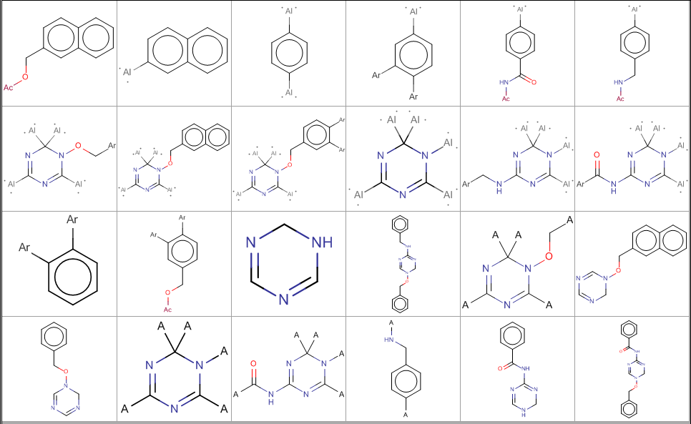
Methods Used to Exhaustively Generate Overlapping Shared Scaffolds
1
Molecule
Scaffold(s)
NCATS
R-Group Tool
Related Molecules
Scaffold
Network
Hierarchical
Directed Graph
of Scaffolds
Frameworks Optimized for R-group tables
Rings
4
3
2
Frameworks (GSK) Bemis-Murcko like & RECAP

Slide 12

Details: Integrating Clusters and Scaffold Generation Methods in a Single Spotfire Visualization
Main Data Table: ChemBLNTD_GSK
Compound ID, SMILES, Properties, Activities
Molecule
Scaffold(s)
Compound ID
Related Molecules
Clusters (Copy)
Frames (Copy)
RG Decomp
(Copy)
Top-Level Scaffolds
(Copy)
Cluster ID
(one)
Framework
ID (many)
Scaffold ID
(many)
Scaffold
ID (one)
Cluster ID, Cluster Size, Cpd IDs
(Original)
Framework ID,
FW SMILES,
Cpd IDs
(Original)
Properties & activities aggregated by scaffold
scaffold → subscaffold
n
Scaffold ID
(many)
Clustering
Data-Driven
Frameworks
Scaffold ID
(many)
subscaffold → scaffold
n
Scaffold info:
IDs, SMILES Cpd Info: IDs, SMILES, Properties
Scaffold ID
(many)
Compound Exemplars from Top-Level Scaffold
NCATS R-Group tool
Scaffold Network Generator

Slide 13
Outline
Introduction:
Merging disparate screening output
Methods – Scaffold Analytics
Limitations of Clustering
Walking between Scaffolds
Scaffold Generation Methods
Results – Linking series across datasets
Hit prioritization & Scaffold Hopping (TCAMS)
Dataset Integration & Scaffold Progression (Kinase X)
Conclusion

Slide 14

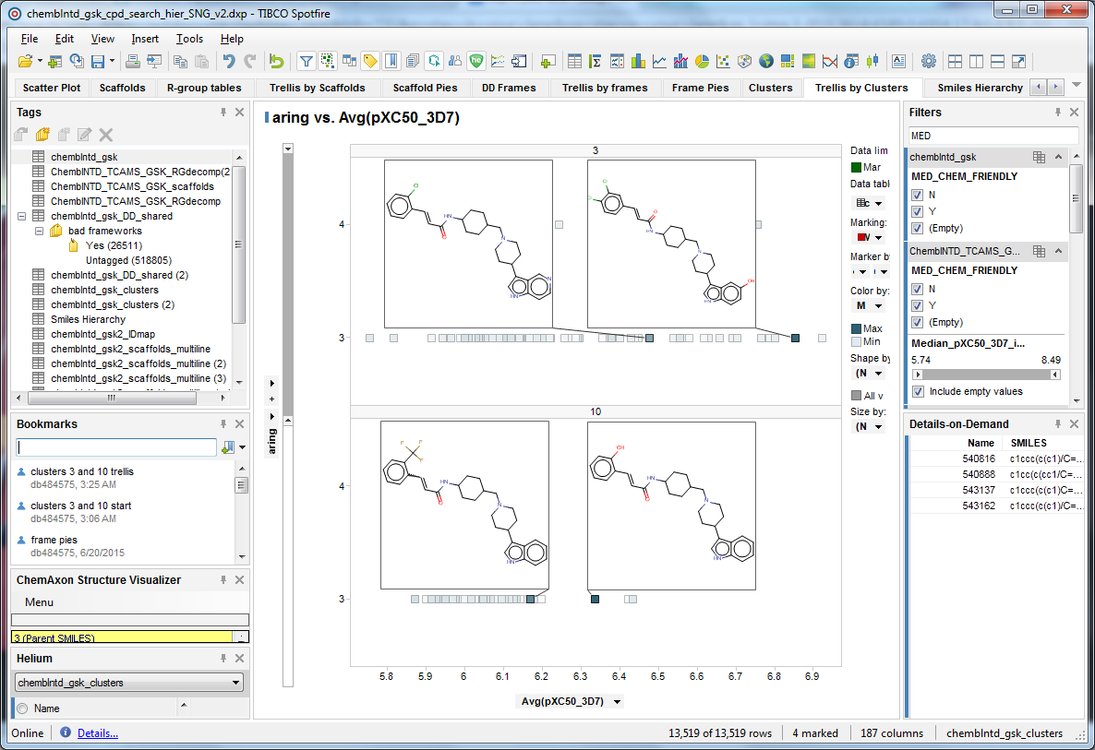
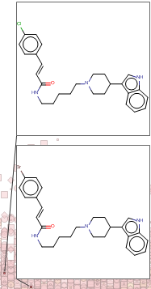
Hit Prioritization via Clustering: Exploration within Pre-determined Groups Only
Hit
Prioritization
~2000 complete linkage clusters in TCAMS set
Initial clustering limits neighbors you can discover
Query molecules (scatter plot)
IFI
# aromatic rings
Percent inh. in DD2 (PF resistant strain)
pXC50 in 3D7 (PF susceptible strain)

Slide 15
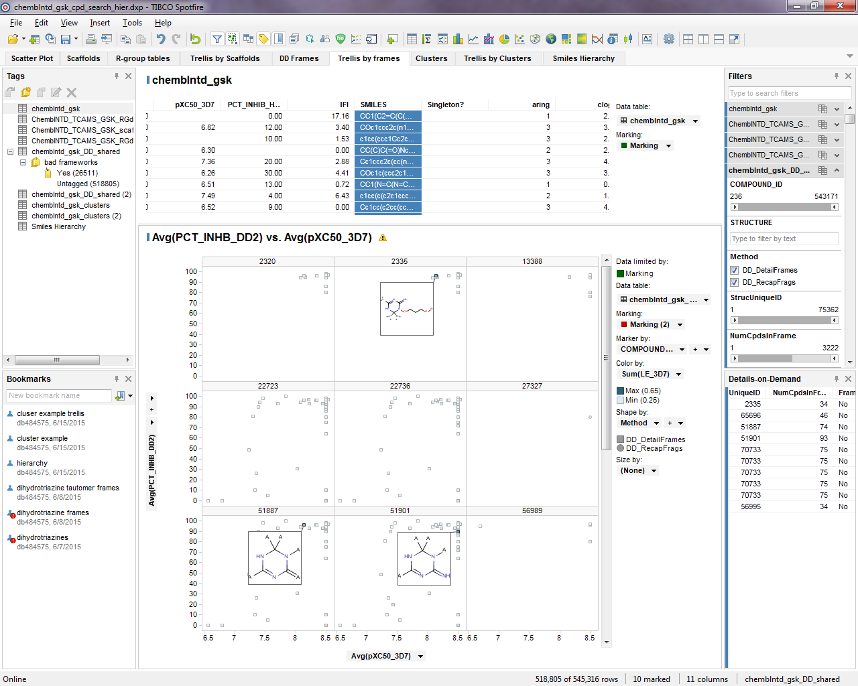
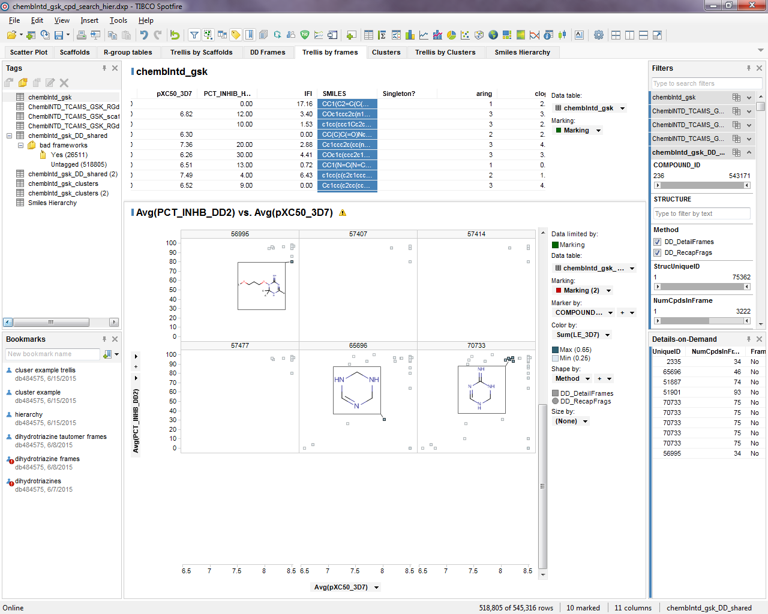
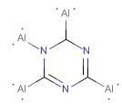
Hit Prioritization via Frameworks
Hit
Prioritization
80k GSK frameworks, 7.5k RECAP fragments in TCAMS set
Issues identified:
Many equivalent and redundant frameworks
Tautomers not unified by current code
Score of a framework = Average activity of molecules containing it
low-scoring frameworks can be filtered out

Slide 16
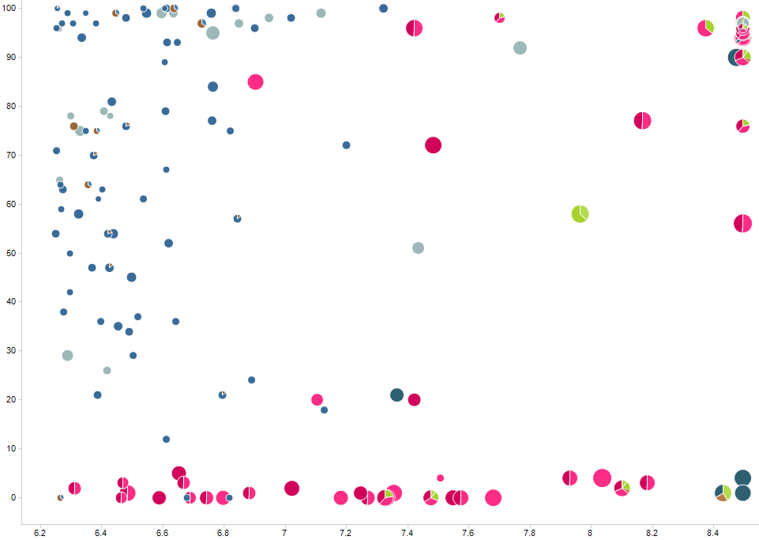
Spotfire Visualization of Framework Overlaps: Help Identify SAR Trends and Prioritize Hits
Hit
Prioritization
Each pie is one compound
Each sector/color is one framework
Exemplar compounds
Framework
moderately
active
Frame-
work not
active
Percent inhibition in DD2 (PF resistant strain)
Frameworks
active and
overlapping
Color by:
Framework
Sector size:
# molecules
Size by:
Ligand
Efficiency
pXC50 in 3D7 (PF susceptible strain)

Slide 17
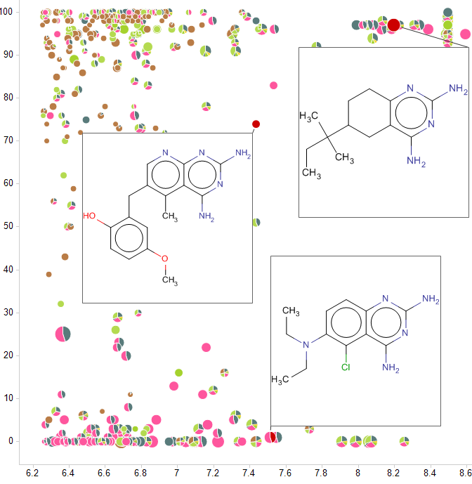
Spotfire Visualization of Framework Overlaps: Reveal Potential Scaffold Hops
Scaffold
Hopping
?
Each pie is one compound
Each sector/color is one framework
Shared framework,
Related chemotypes
Opportunity to design hybrid series
Percent inhibition in DD2 (PF resistant strain)
Color by:
Framework
Sector size:
# molecules
Size by:
Ligand
Efficiency
Molecule
Scaffold(s)
Related Molecules
pXC50 in 3D7 (PF susceptible strain)

Slide 18
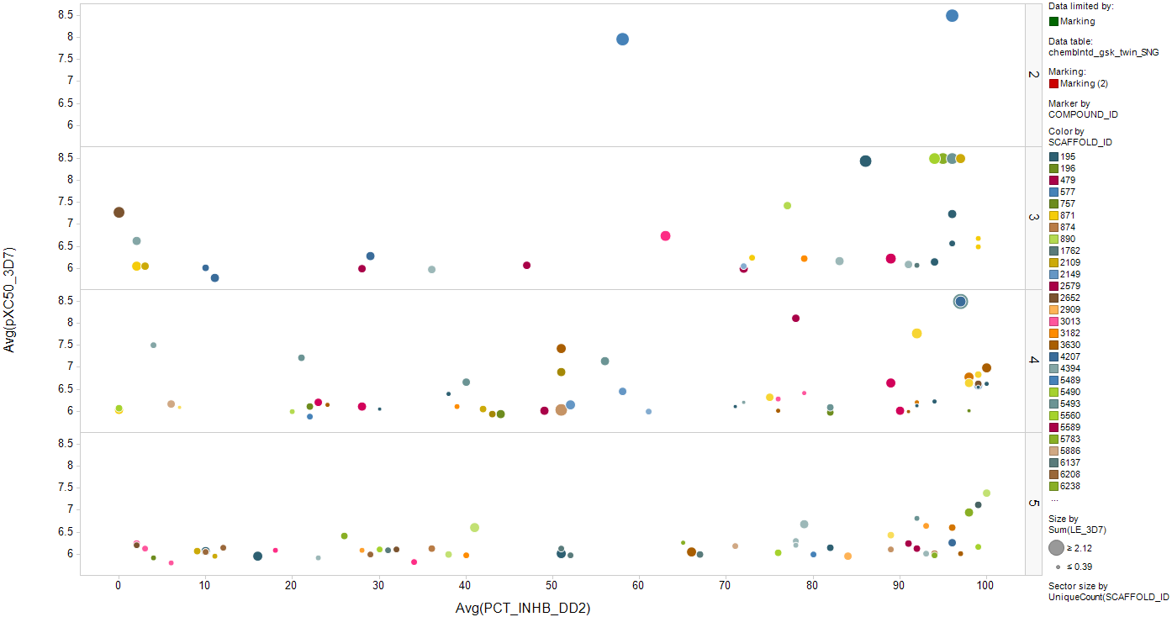
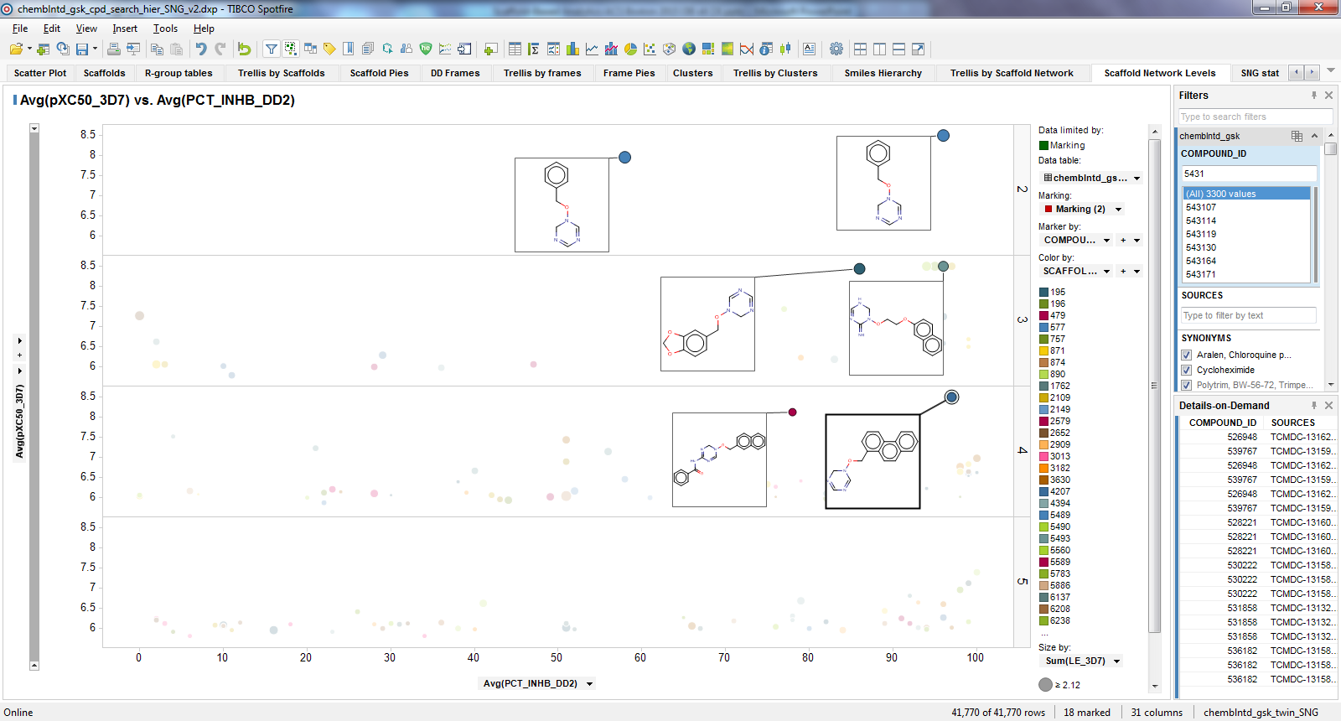
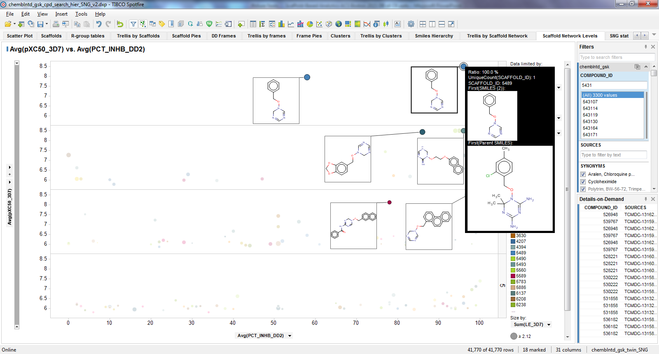
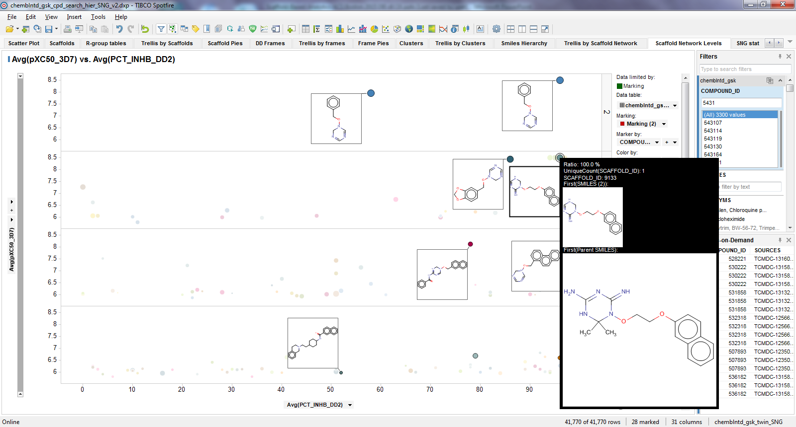
Hit Prioritization via Scaffold Networks: Navigate to Related Scaffolds
Hit
Prioritization
13.5k compounds map to 7715 top-level scaffolds (28.5k total)
Rings
Color by:
Top-Level Scaffold
Size by:
Ligand Efficiency
Trellis by:
Number
of rings in
scaffold
2
3
pXC50 in 3D7 (PF susceptible strain)
4
Percent inhibition in DD2 (PF resistant strain)

Slide 19
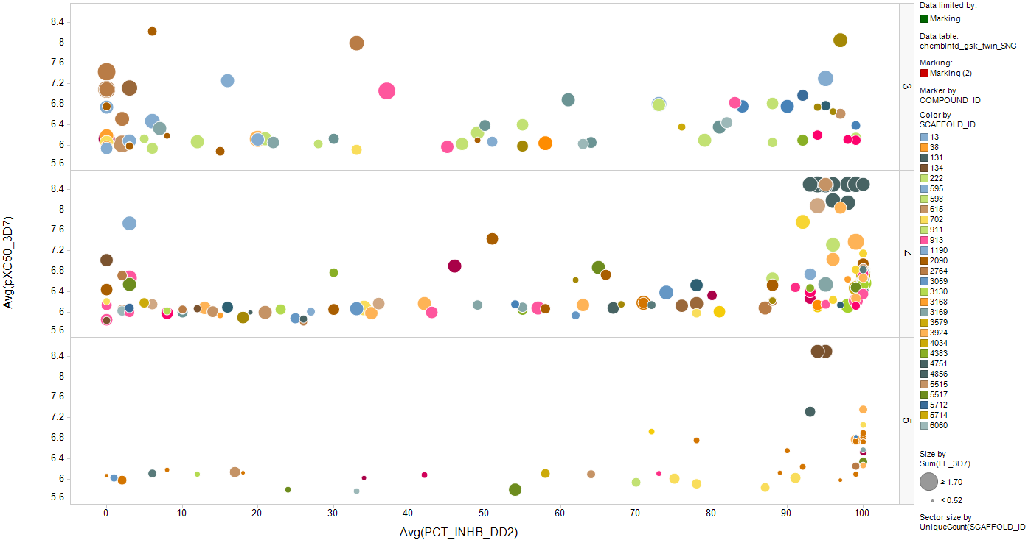
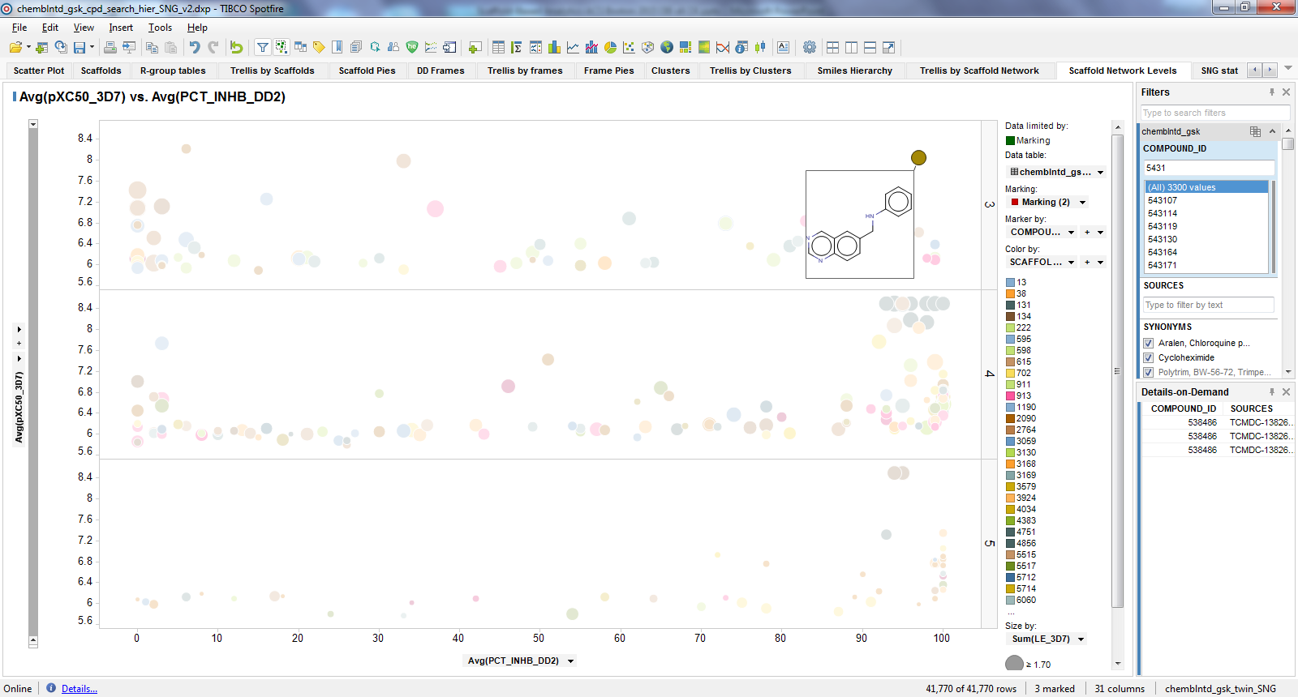
Scaffold Hopping via Scaffold Networks: Identify Scaffolds with a Desirable Profile
Scaffold
Hopping
?
Original tricyclic scaffold inactive
against resistant DD2 strain
Find new bicyclic and tricyclic scaffolds
active against resistant DD2 strain
pXC50 in 3D7 (PF susceptible strain)
Color by:
Top-Level Scaffold
Size by:
Ligand Efficiency
Percent inhibition in DD2 (PF resistant strain)

Slide 20
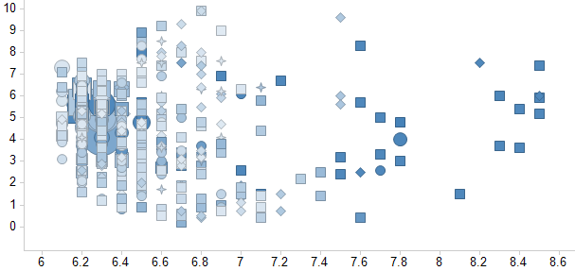
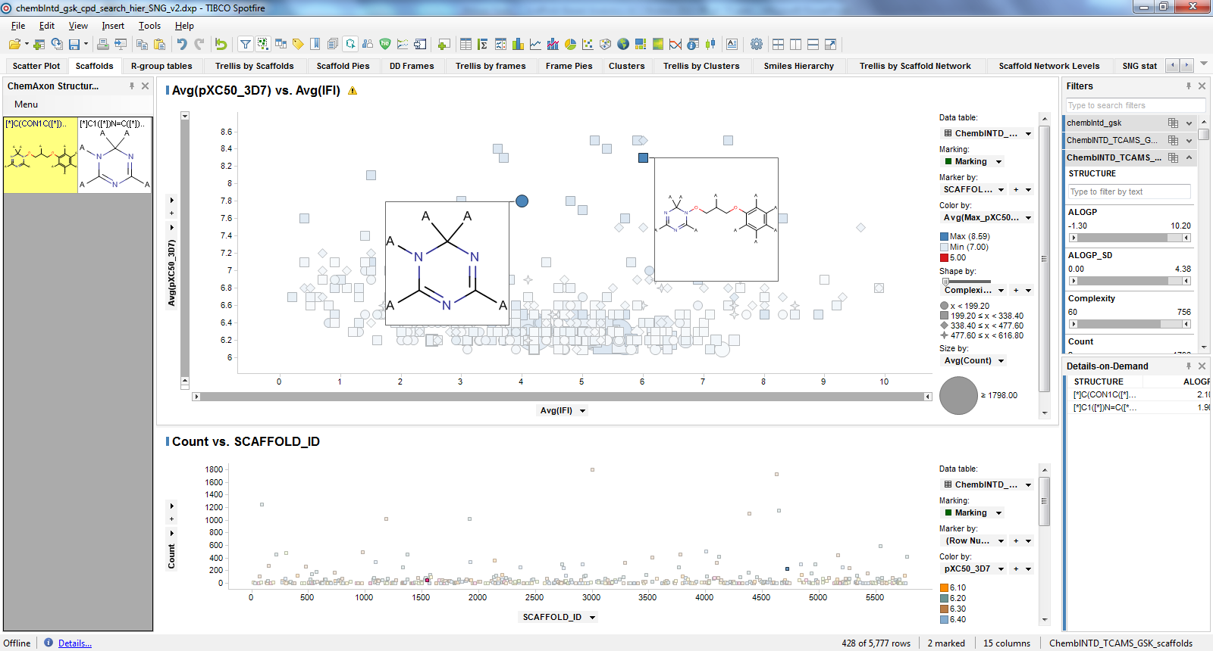
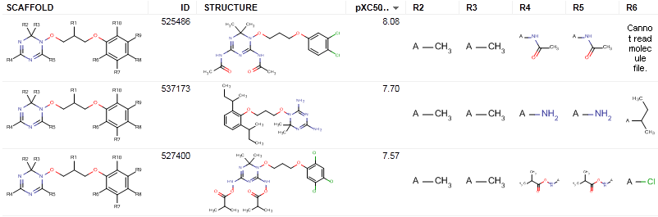
Hit Prioritization via NCATS R-Group Tool: Scaffolds, Summary Data and Drill-Down
Hit
Prioritization
5.7k scaffolds, filtered to 428 using aggregate (max) pXC50
Minimum # of “useful” scaffolds
Tautomers under single scaffold
Avg. IFI
Avg. pXC50 in 3D7 (PF sensitive strain)
Bonus: sensible R-group tables generated

Slide 21
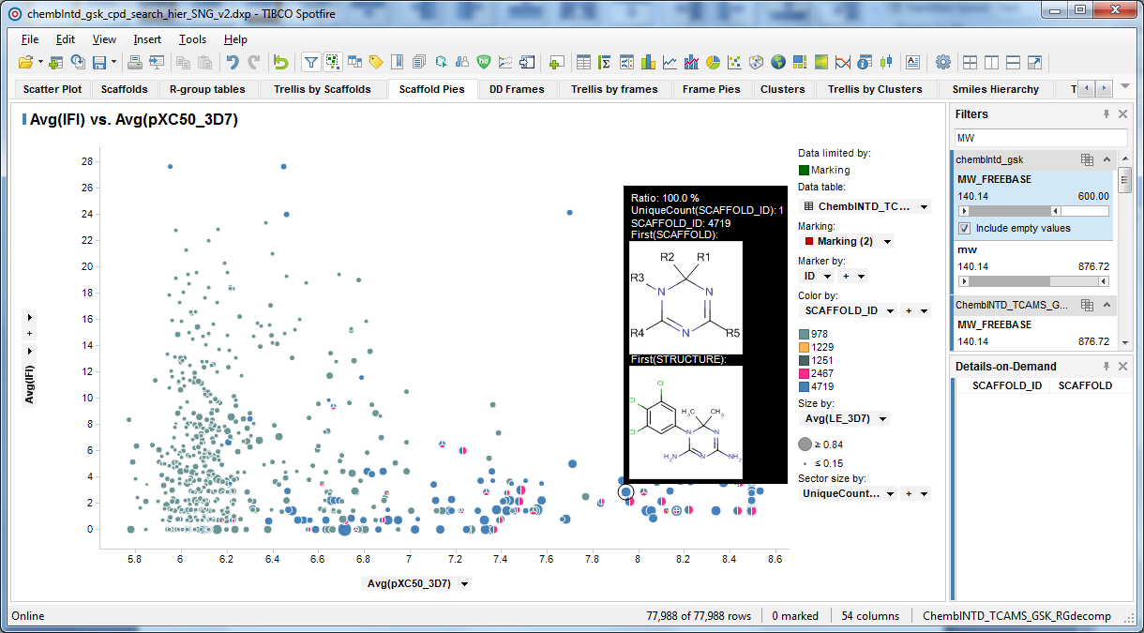
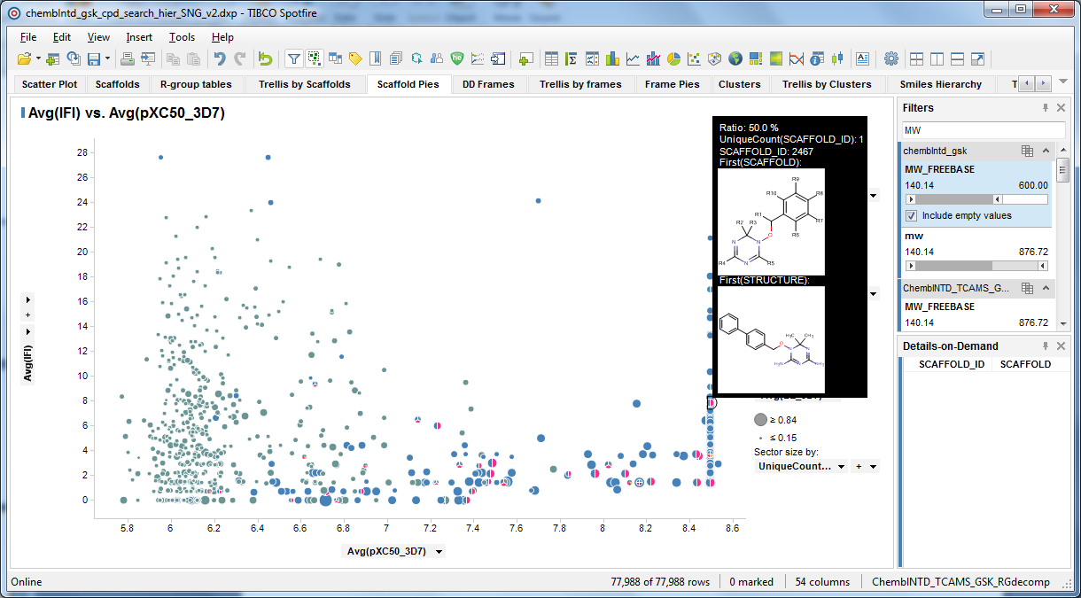
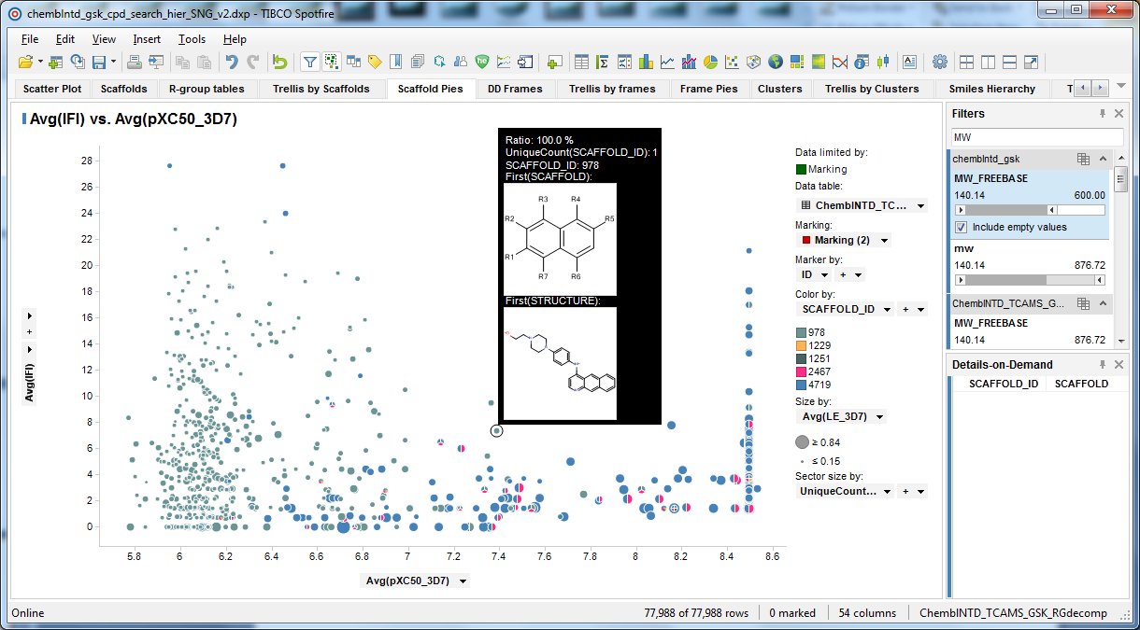
Hit Prioritization via NCATS R-Group Tool: Visualizing Scaffold Overlap and Activity
Hit
Prioritization
Each pie is one compound
Each sector/color is one scaffold
Scaffold 978 alone
not highly active
Co-occurring
active scaffolds
Scaffold 4719
active by itself
IFI
pXC50 in 3D7 (PF susceptible strain)

Slide 22
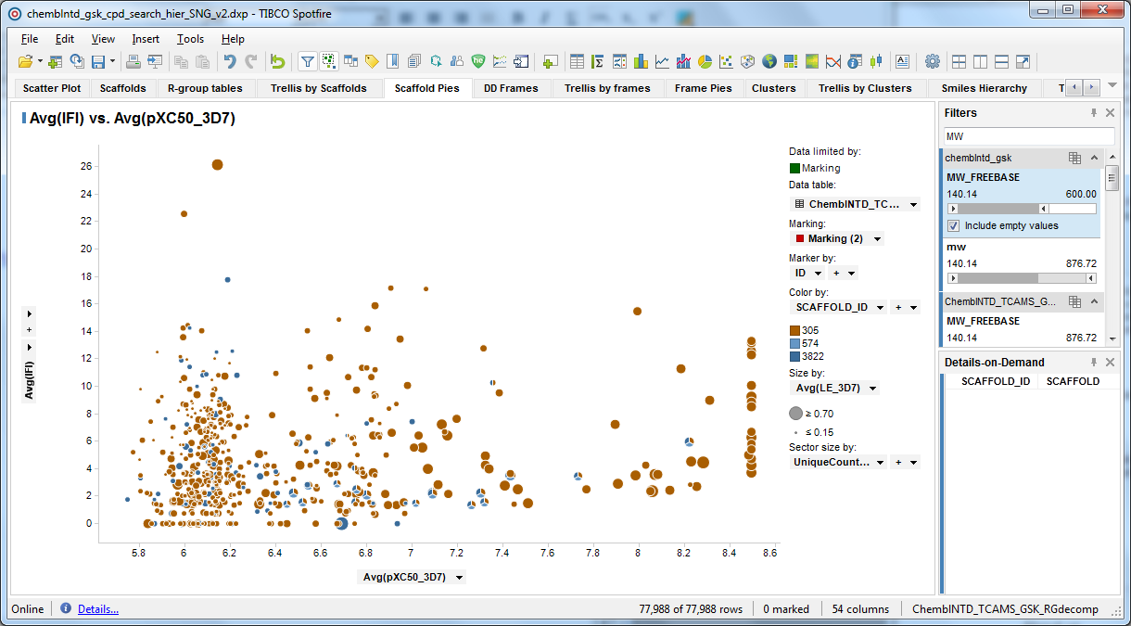
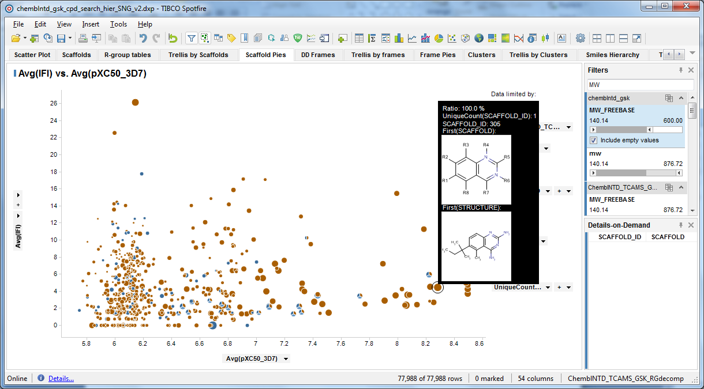
Scaffold Hopping via NCATS R-Group Tool: Deconstruct SAR
Scaffold
Hopping
?
Each pie is one compound
Each sector/color is one scaffold
Indazoles
alone only
weakly active
Discover alt. tricycles
IFI
Quinazolines
alone active,
ligand efficient
Fuse Design Ideas
pXC50 in 3D7 (PF susceptible strain)

Slide 23
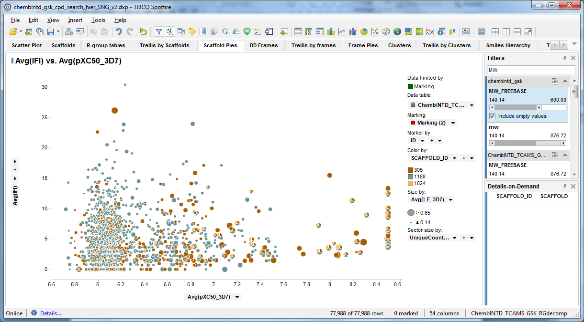
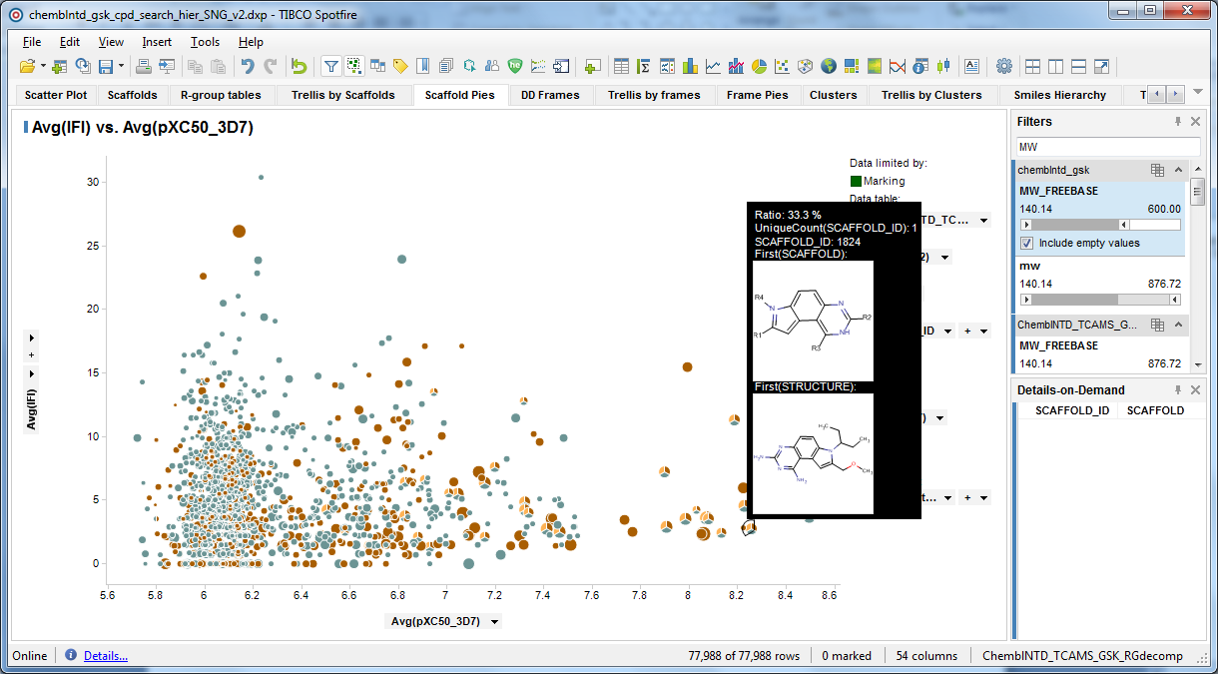
Scaffold Hopping via NCATS R-Group Tool: Iterative SAR Exploration
Scaffold
Hopping
?
Each pie is one compound
Each sector/color is one scaffold
New tricycle scaffold
(1824) seems more
active than indoles or
quinazolines alone
IFI
pXC50 in 3D7 (PF susceptible strain)

Slide 24
Scaffold-Based Decision Making and Hit ID Integration
Dataset
Integration
Kinase X
Candidate compound demonstrates exquisite kinase selectivity
Active against Wild-Type, Inactive against Mutant enzyme
Backup program
New screens analyzed & integrated using NIH Scaffold Analysis
2011 2012 2014 (backup)
Fragment hits 288 pIC50s
HTS 2012 2M screened 4564 pIC50s
HTS 2014 350K top-up 3613 pIC50s
Chiromics diversity lib 557 features
DNA ELT
130 libraries 824 features
9816
cpds
Activity data available
No activity data
Goal: identify selective backup series from new Hit ID efforts
Notes:
We used the scaffolds to merge all of this data and identify more series that bind selectively

Slide 25
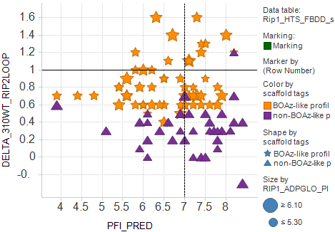
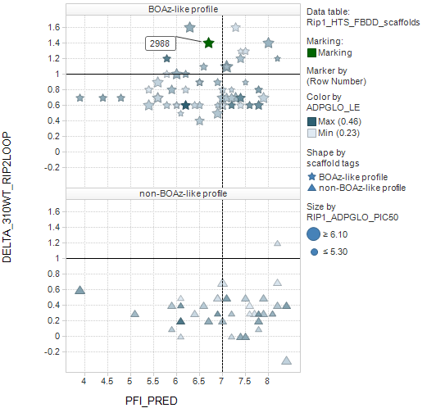
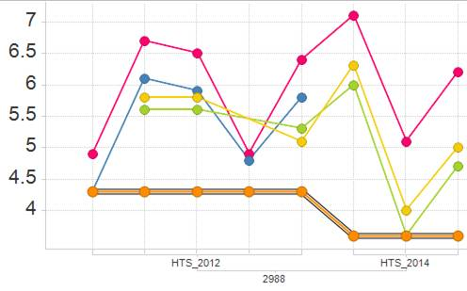
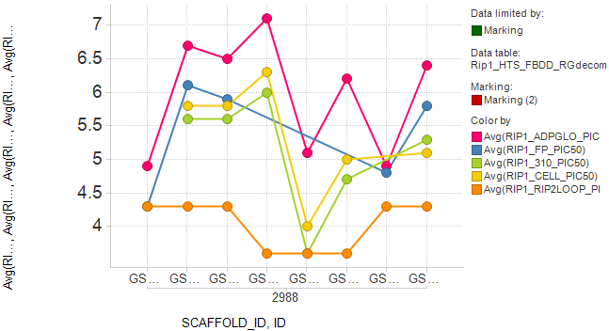
Selective Lead Series Linked Across Datasets
Dataset
Integration
Scaffold classification by mutant binding
Scaffold-Level Details:
Statistics Mech. pIC₅₀: 6.0 ± 0.88
Cell pIC₅₀: 5.3 ± 0.81
LE: 0.35 ± 0.05
Mean Δ( WT pIC₅₀ – mutant pIC₅₀ )
Assay Drill-Down:
Selective WT/mut.
2014
2012
Non-selective
Mechanistic
Size: pIC50
pIC₅₀
Full-length WT
Truncated WT
Cell
Mean PFI_{pred}
Mutant
Mech. pIC₅₀: 7.1
Cell pIC₅₀: 6.3
LE: 0.44
GSK Compound ID
Chemistry initiated on series!
HTS 2014 hit
HTS 2012 hit (not followed up)

Slide 26



Identify and Test Unmeasured Compounds Based on Overlap with Actives
Dataset
Integration
Low MW/PFI
untested
fragment
Low MW/PFI
ELT feature
to synthesize
Ligand-efficient
HTS_2014 hit
MW
Low MW/PFI
ELT features
to synthesize
Color by LE
Low MW/PFI
untested
fragment
Shape by:
Ligand-efficient
HTS_2014 hit
PFI
PFI

Slide 27
Outline
Introduction:
Merging disparate screening output
Methods – Scaffold Analytics
Limitations of Clustering
Walking between Scaffolds
Comparison of Scaffold Generation Methods
Results – Linking series across datasets
Hit prioritization & Scaffold Hopping (TCAMS)
Dataset Integration & Scaffold Progression (Kinase X)
Conclusion

Slide 28
Conclusions and Future Directions
Merging datasets using scaffolds enables a cohesive visualization of chemical series and suggests opportunities for hybridization
Automated scaffold and R-group generation is a powerful method for hit prioritization and scaffold hopping in large & diverse datasets
Partitioning into clusters is ambiguous, incomplete for SAR navigation.
Pros and Cons of Scaffold-Generation Methods:
Frameworks: Exhaustive (complete) / exhaustive (redundant)
NCATS R-Group Tool: R-group-oriented / scaffolds need pruning
Scaffold Network: scales to large datasets / complex visualization/integration
Future improvements:
Scalability to huge and ever-changing datasets
Automated selection of informative overlapping scaffolds
Combining multiple scaffold-generation methods

Slide 29
Thank You & Questions

Slide 30
Backup and References
Scaffold Generation Methods:
NCATS R-group analysis (http://tripod.nih.gov/?p=46 )
Frameworks (Data-Driven Clustering, GSK/ChemAxon)
Scaffold Network Generator (http://swami.wustl.edu/sng)
Agglomerative Clustering (Complete Linkage, GSK/ChemAxon)
NCATS R–group tool @ http://tripod.nih.gov
G. Harper, G. S. Bravi, S. D. Pickett, J. Hussain, and D. V. S. Green. J. Chem. Inf. Comput. Sci., 44(6), 2145-2156 (2004)
M. K. Matlock, J.M. Zaretzki, and S. J. Swamidass. Bioinformatics. 29(20), 2655-2656 (2013).

Slide 31
Conclusions
We used overlapping chemical clusters (scaffolds, frameworks) to organize chemical output from multiple screening datasets.
The methods we tried each have their strong points and reveal slightly different things about the chemical series in the data
Any automated, exhaustive, and quantitative fragmentation can be used to link chemical series across datasets
The key is setting up the visualization and navigation correctly.
Applications demonstrated in the talk:
Hit triage and decision-making at the scaffold level using aggregate (min/max/median) activity
Scaffold hopping to new regions of chemical space
R-group table generation by the NCATS method
Future improvements:
Scalability to huge and ever-changing datasets
Automated reduction to the least number of informative scaffolds

Slide 32



Example: Finding Ways To Lower PFI
Click to pick
PFI_{pred}
Color by LE
0.5
0.1
Empty
PIC₅₀
orig. hit
ArRings
ArRings
PIC₅₀
PIC₅₀
Fewer aromatics but kills potency
Also fewer aromatics but ligand efficient
Notes:
Here is how you would use this in practice
If you wanted to reduce the PFI by removing aromatic rings, you would click on it
And you would see all of the scaffolds in this molecule and all of the OTHER molecules sharing those substructures.
For the scaffold on the left you could conclude that simply removed aromatic rings kills all potency.
For the scaffold on the right, you can delete 2 aromatic rings but retain reasonable potency and have more ligand efficient molecules

Slide 33
Outline
Intro:
Screening methods and SAR analysis
Methods – Scaffold Analytics
Limitations of Clustering
Walking between Scaffolds
Comparison of Scaffold Generation Methods
Results – Linking series across datasets
TCAMS-GSK malaria data
Kinase X (Internal program)
Conclusion
SEE IF IT IS NECESSARY?

